Slide 1
Unlocking the Secrets of Telephone Phreaking
Phreaking and its implications on modern cyber threats

Slide 2
Agenda
Who am I?
What is Phreaking?
Telephony
POTS vs VoIP
Phreaking History
Evolution
Significance
Classic Phreaking tools and techniques
Emerging threats in telephony
Risks and consequences
Mitigation and best practices
Proactive defense

Slide 3
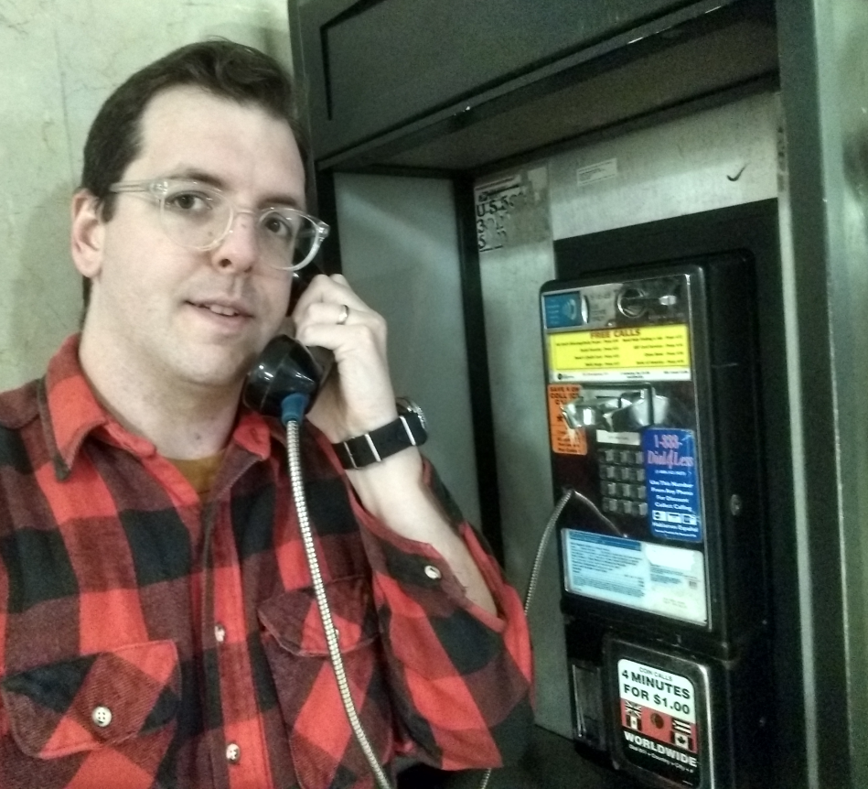
Who Am I?
Co-Founder of the PhilTel project, aiming to install free-to-use payphones within Philadelphia
Run the Philly 2600 hacking meetups
Not in InfoSec
Software Engineer
Views expressed here are my own, not those of my employer
Fascinated by hacker/phreaker culture and history

Slide 4

“Phreaking”
A slang term coined to describe the activity of a culture of people who study, experiment with, or explore telecommunication systems, such as equipment and systems connected to public telephone networks
Phreaking is not always about toll fraud or malicious activities

Slide 5
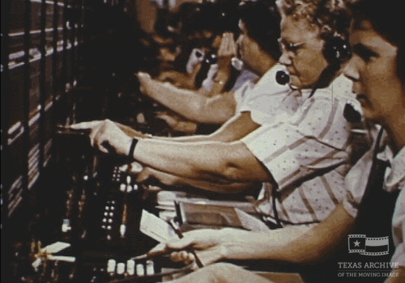
Telephony

Slide 6
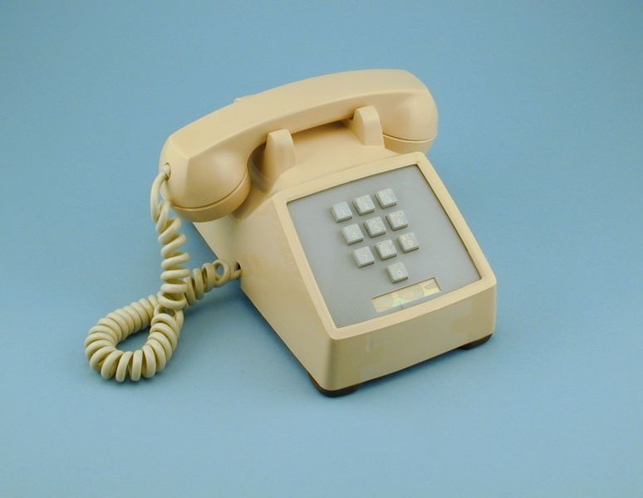
Telephony

Slide 7
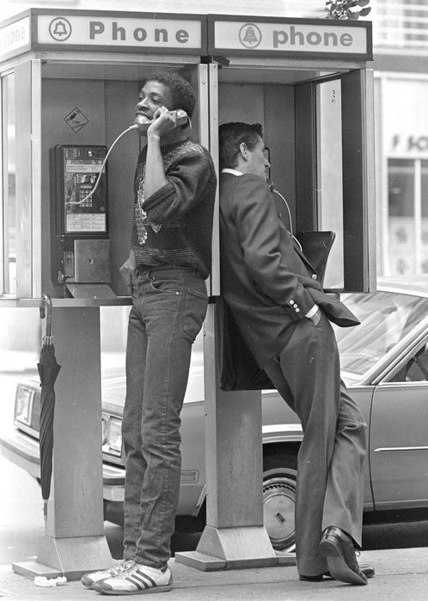
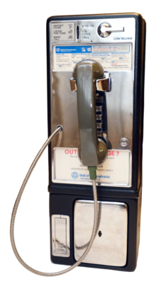
Telephony

Slide 8
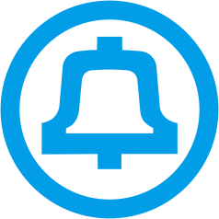
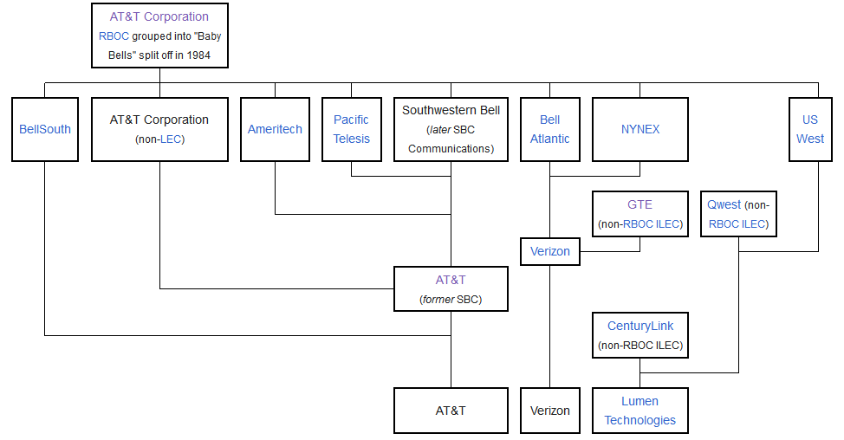
“The Phone Company”

Slide 9
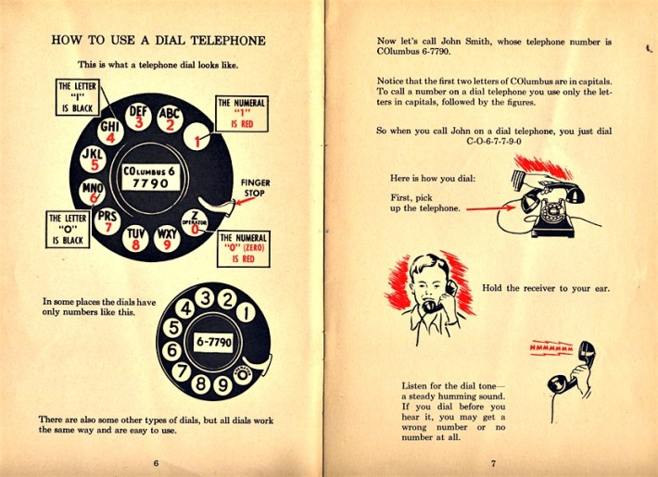
Telephone Numbers

Slide 10
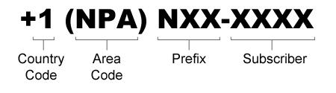
Telephone Numbers
NPA = Number Plan Area

Slide 11
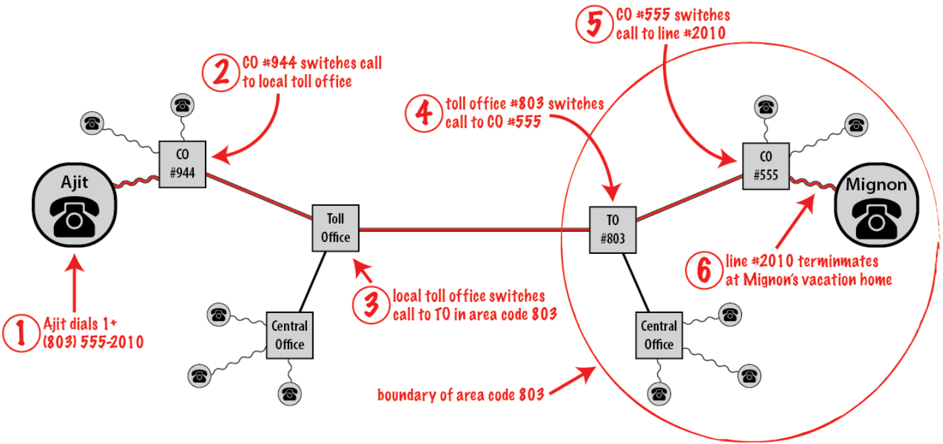
Analog/Digital Telephony (POTS)

Slide 12
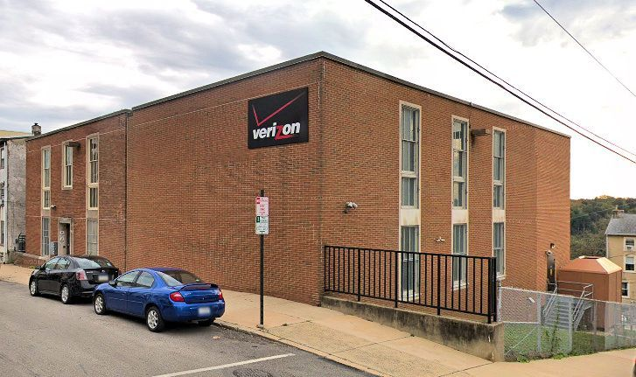
Analog/Digital Telephony (POTS)
Central Office
Exchange
Local Loop (Subscriber line)
Literally a direct circuit between two phones
Circuit-Switched
Physical path dedicated to one connection
Controlled by big Telcos

Slide 13
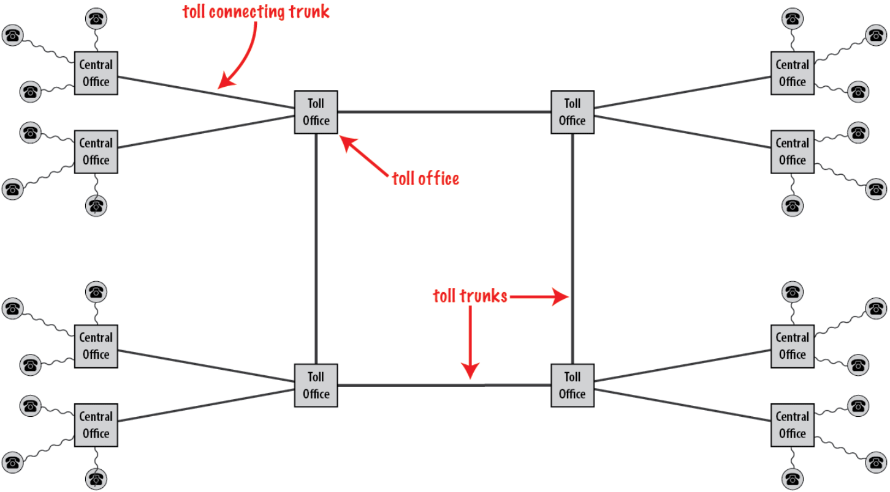
Analog Telephony (POTS)

Slide 14
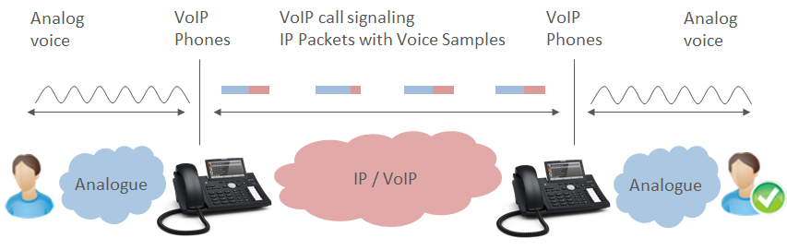
IP Telephony (VoIP)
Voice-over-Internet-Protocol
Telephony over the Internet
Packet-Switched
Not a dedicated physical medium
Inexpensive

Slide 15
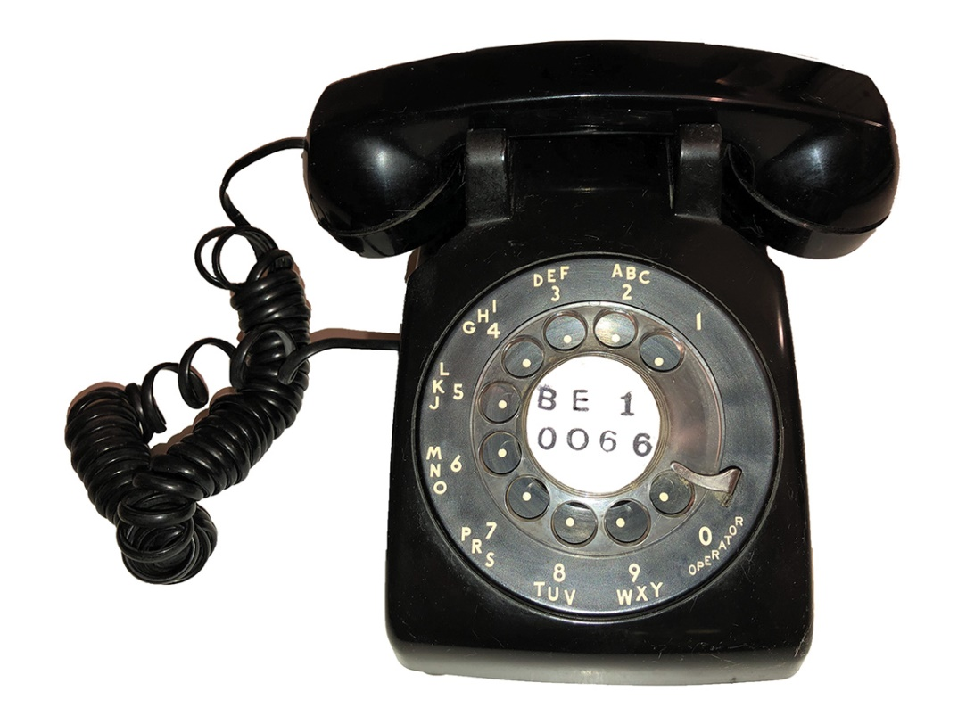
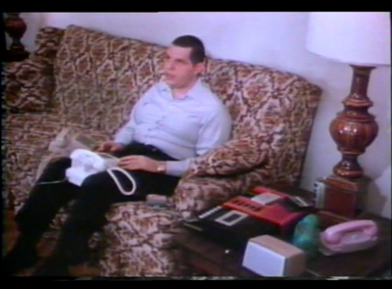
Phreaking History
Joybubbles discovered he could “hook-flash” a phone to dial numbers. Later, he discovered he had perfect pitch and could shut off telephone messages and place calls by whistling at 2600Hz

Slide 16
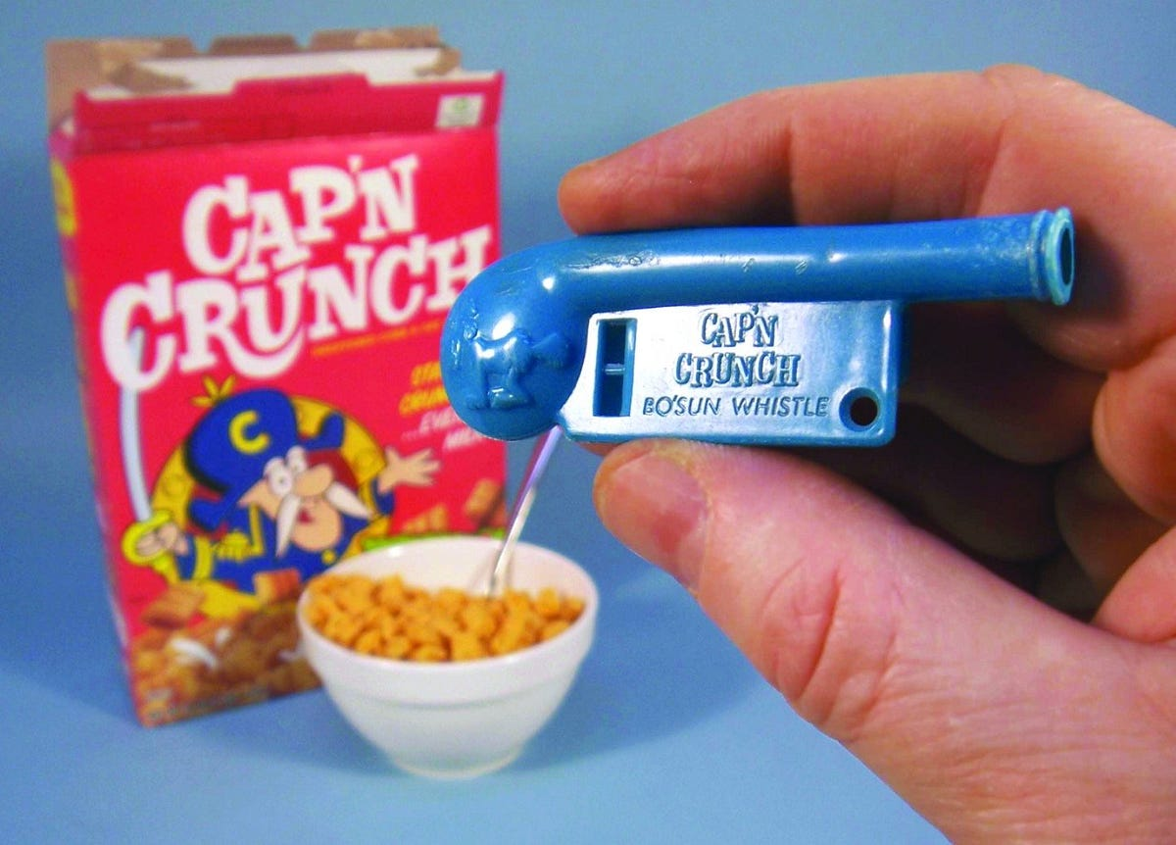
Phreaking History
Captain Crunch (John Draper), discovered a Cap’n Crunch Bo’sun whistle given as a toy in cereal boxes could produce that same 2600Hz tone.

Slide 17
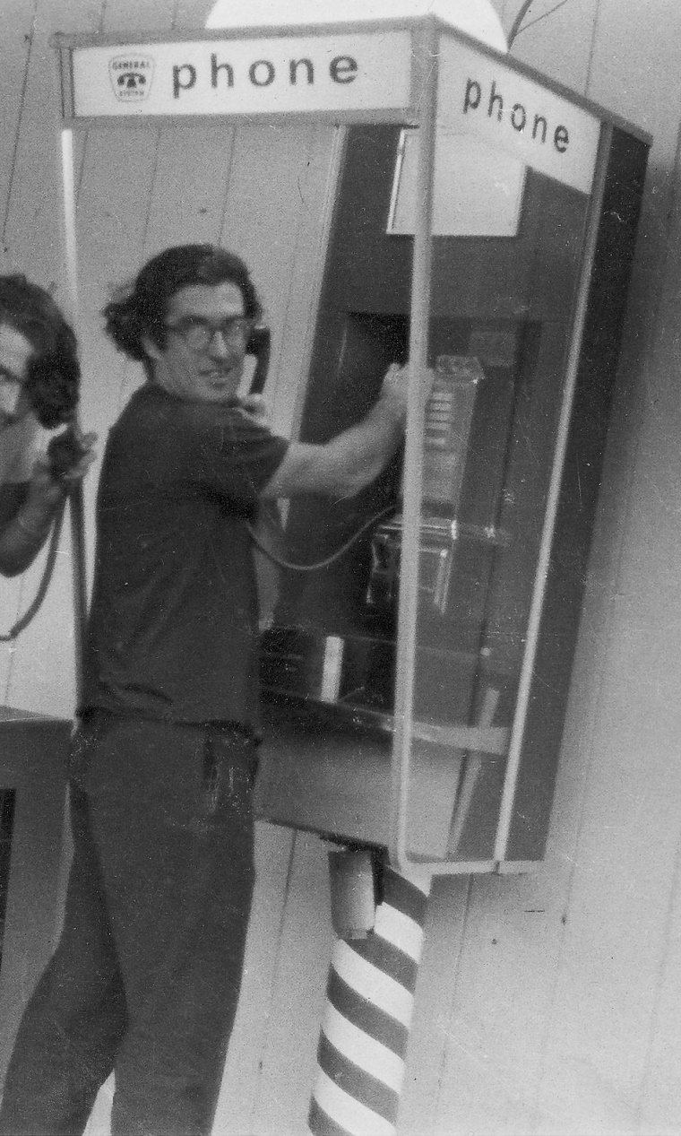

Phreaking History
Crunch was an early user and builder of Blue Boxes (used for making free long distance calls) and was featured in the 1971 Esquire article “Secrets of the Little Blue Box” with Joybubbles

Slide 18
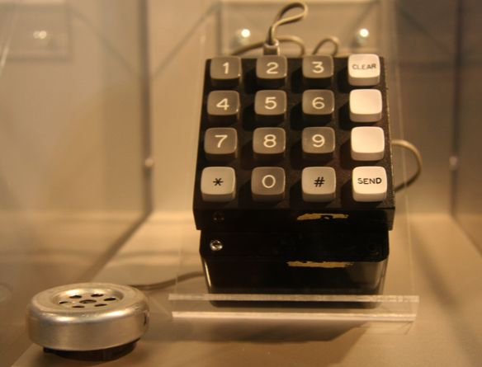
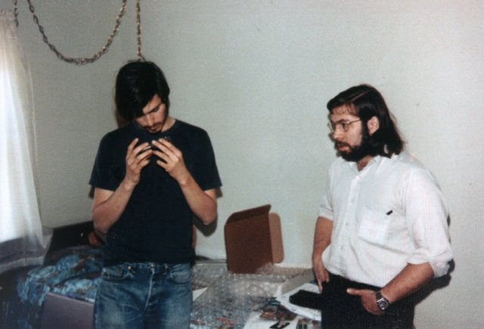
Phreaking History
Phreaking exploded in popularity, inspiring a whole generation to tinker with the phone network
Phreaks had their own magazines/newsletters (TAP, 2600), phreaking was seen in movies (WarGames), contributing to the ‘70s/’80s zeitgeist

Slide 19
Phreaking Evolution
Phreaks were constantly playing a cat and mouse game with Bell (and its descendants)
While more attention was drawn to phreaking, toll fraud increased, giving phreaking a bad name
Eventually, phone companies would patch their security holes and render techniques obsolete
More modern malicious phreaking targets Private Branch Exchanges (PBXs) owned by individuals/businesses
There are still people exploring the phone network, especially focusing on more traditional elements, like circuit switching, payphones, etc.

Slide 20
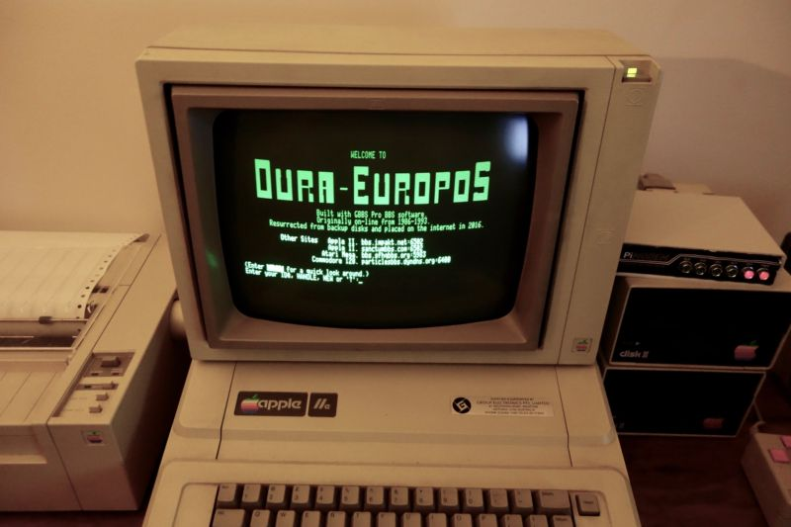
Phreaking Significance
Modern hacking/InfoSec movements can trace its roots back to phreaking
With the advent of personal computing in the 1980s, many curious and tech-savvy people would communicate over bulletin board systems to share information about exploring the phone system and, increasingly, the computers that were connected to it

Slide 21
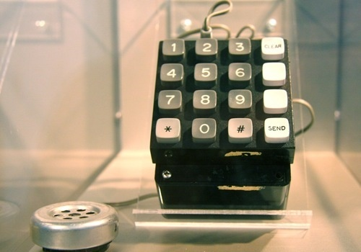
Phreaking Tool: Blue Box
Exploited In-band Signaling (like SS5)
Early blue boxes were single-frequency (SF) only, sending 2600Hz in different lengths and quantities to setup a call
Later blue boxes utilized multi-frequency (MF) tones

Slide 22
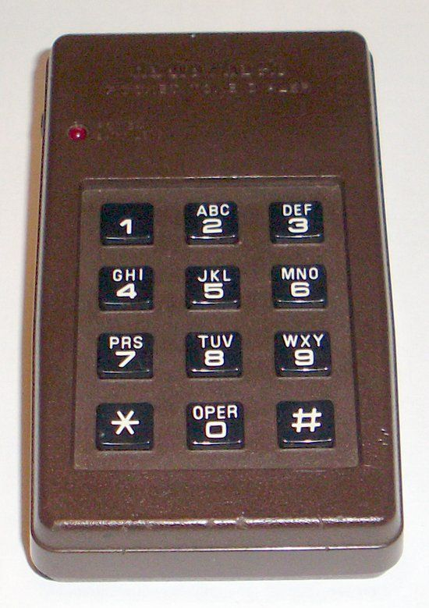
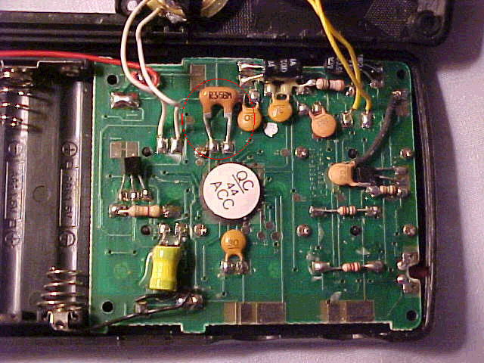
Phreaking Tool: Red Box
Mimicked a nickel tone generated by a payphone to report that a coin had been inserted. Larger coins play the same tone multiple times
Radio Shack tone dialers were often modified with a 6.5536 MHz crystal, allowing the user to press the * key to generate the coin tone

Slide 23
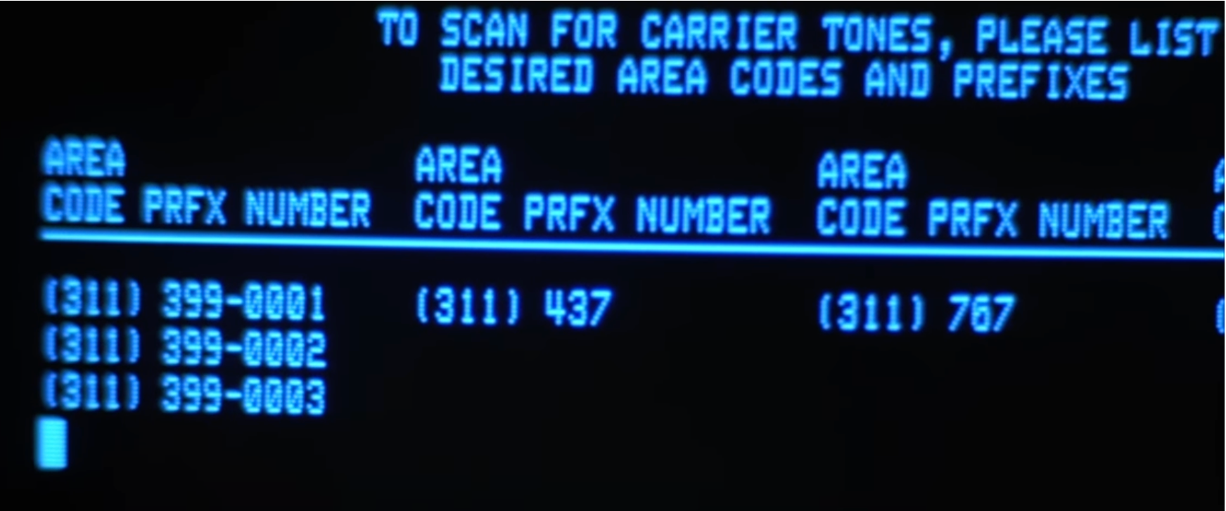
Phreaking Technique: War Dialing
Using automated software to scan a range of telephone numbers to look for modems, computers, and other systems connected to the phone line
Often combined with Calling Card Fraud
Call long distance provider, try card digits, dial a modem

Slide 24
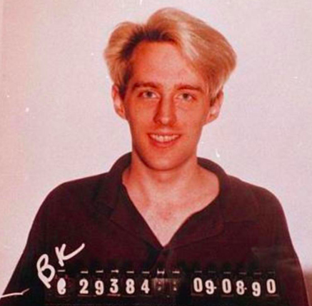
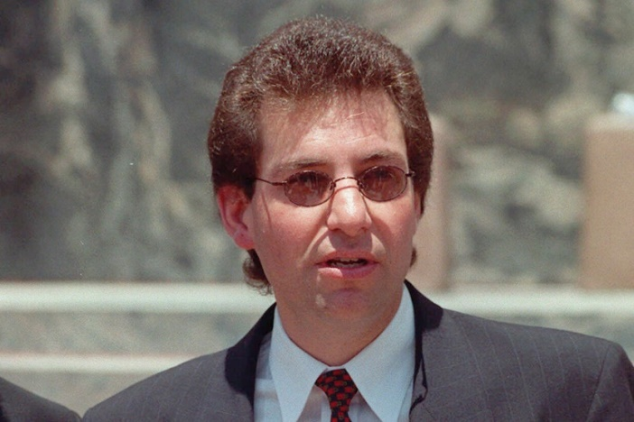
Phreaking Technique: Social Engineering
Talking a target into revealing specific information or performing a specific action for illegitimate reasons
Phreaks would social engineer telephone operators pretending to be Telco personnel
Social Engineering is still prominent today. Hackers breached MGM last year by impersonating an employee in a voice social engineering attack that targeted the company's help desk (RN)

Slide 25
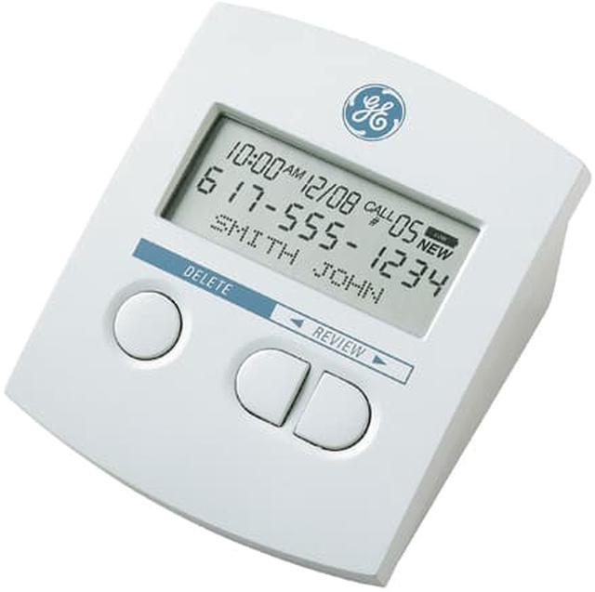
Emerging Threat: Caller ID Spoofing, Vishing
An attack that causes a target's phone to display a phone number different than the one originating a call
This is actually a legitimate feature, used illegitimately!
Vishing often utilizes caller ID spoofing to get sensitive information from targets
Case Study: iSpoof (2002)
Targeted 142 people in Europe
10 million fraudulent calls
Posed as bank personnel
Scammed $121 million

Slide 26
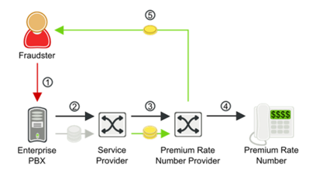
Emerging Threat: PBX Hacking
Many modern Voice-over-IP systems can be setup quickly with default or poorly configured options
Default password for account, allow call forwarding
Attackers can then use these systems to call toll numbers they own which charges the owner of the phone system
Case study: Noor Aziz Uddin (2015)
Active 2008-2012
Grossed $50 million

Slide 27
Risks and Consequences
While VoIP can be inexpensive and easy to use, it is rife with fraud and hacking
Targets could divulge sensitive information or have their own systems hijacked to drive up a large phone bill
Phone systems are just as vulnerable and exploitable as computers, and they often ARE just normal computers
Phones also connect to the Internet and provide an entry point into your environment. People underestimate the risk of phone systems. Printers as well (RN)

Slide 28
Mitigation Strategies & Best Practices
If someone calling you on the phone doesn’t seem quite right, they probably aren’t
Always lookup the company’s number and use that to call back
Fully configure your VoIP systems (or find someone who can)
Just because it works out of the box doesn’t mean it is configured well out of the box
Keep a limit on calling credit in case of abuse
Not just with VoIP, all system accounts should be changed from default and user access should be reviewed at least annually. Preferably quarterly (RN)

Slide 29
Proactive Defense
Have authentication policies in place. Use unique SIP credentials, have tooling to block peers after bad attempts
Enforce access control, don’t allow people to have access to calling features they don’t need
Use encryption for SIP/RTP (SIPS/SRTP)
Educate users on best practices, vishing can be just as detrimental as email phishing!
Yes, your employees are your fist line of defense. Arm them with the knowledge to protect your organization (RN)

Slide 30
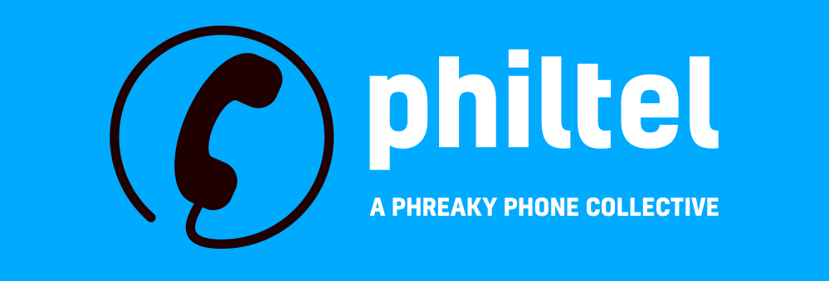
Thank You!
Mike Dank
mike@philtel.org
https://philtel.org

